Slide 1
ONLINE EVENT MANAGEMENT SYSTEM SUBMITTED BY: PRATHYUSHA CH RAMYAKANTHI K ANUSHA V JHANSI DEVIKA G

Slide 2
ABSTRACT
This is an online event management system software project that serves the functionality of an event manager. The system allows only registered users to login and new users are allowed to resister on the application. This is proposed to be a web application. The project provides most of the basic functionality required for an event. It allows the user to select from a list of event types. Once the user enters an event type eg(Marriage, Dance Show etc), the system then allows the user to select the date and time of event, place and the event equipment’s. All this data is logged in the database and the user is given a receipt number for his booking. This data is then sent to the administrator (website owner) and they may interact with the client as per his requirements and his contact data stored in the database.

Slide 3
BASE STUDY
The project will consists of 2 parts admin (organizer) and user. The organizer will list the names of the events. By this process all resources will available in a single place.
By this there is no loss of data because all the data will be stored in the database.

Slide 4
EXISTING SYSTEM
The present system is completely manual.
Many problems were identified during the initial study of the existing system.
To develop this event management system, detailed study is made in our local college.
Our project event management system , is in its infancy. There for all the works are done manually. The bookings for food, transportation etc. are done orally.

Slide 5
EXISTING SYSTEM
Customers had to go to the company or use oral models like telephone etc to gather information, place order, and view details.
Often there is loss of data and even misconceptions and misunderstandings.
Payment is also not computerized. There are chances for collisions of events and it is quite difficult to manage things. Monthly report generation is also manual.

Slide 6
DISADVANTAGES
Wastage of time: -The time needed to searching the details of transactions and stock is a complex procedure and consumes lot of time.

Slide 7
PROPOSED SYSTEM
The proposed system is interactive, highly user friendly and designed exclusively for the event team.
The system covers almost all the functional areas of the event. The event management system is a database system used to store the information regarding event details, customer details etc.
The computerization of the system allows the easy maintenance of the details.
Speed, accuracy, storage capacity, versatility, automation etc. are the advantages of using a computerized system.

Slide 8
ADVANTAGES
The system is useful as it calculates an exact cost for all the resources required during the event.
The user gets all the resources at a single place instead of wandering around for these.
Make the proposed system more accurate and faster
This system is effective and saves time and cost of the users
Provide user-friendlier environment.
The system should provide high security.
Generates the bills of each transaction.
Make searching for a event places and there booking details
Upgrading can be done with a faster rate.

Slide 9
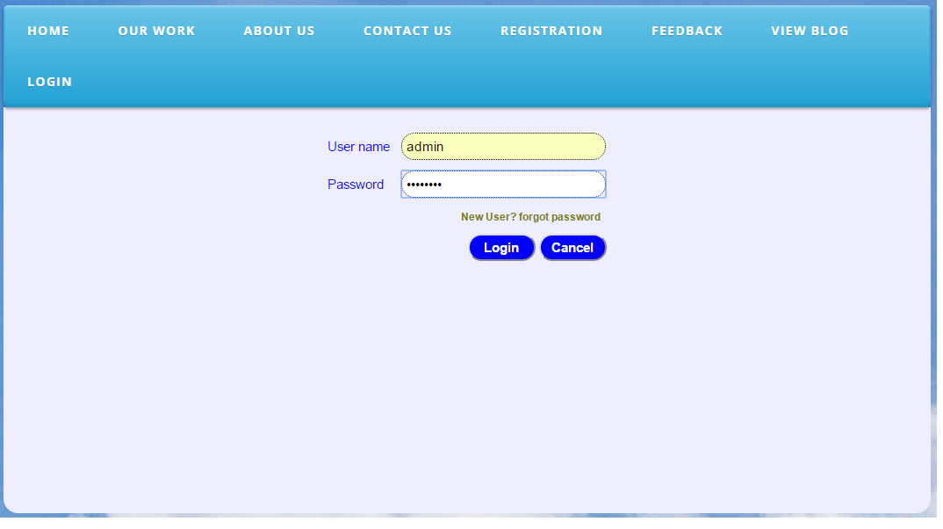
login

Slide 10
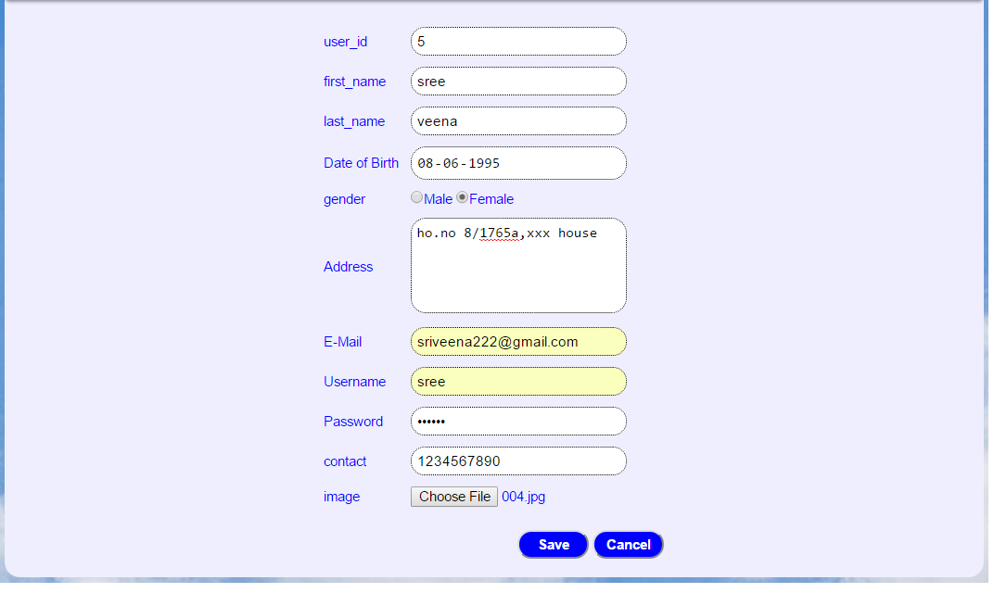
Registration From

Slide 11
THANK YOU

